Slide 1
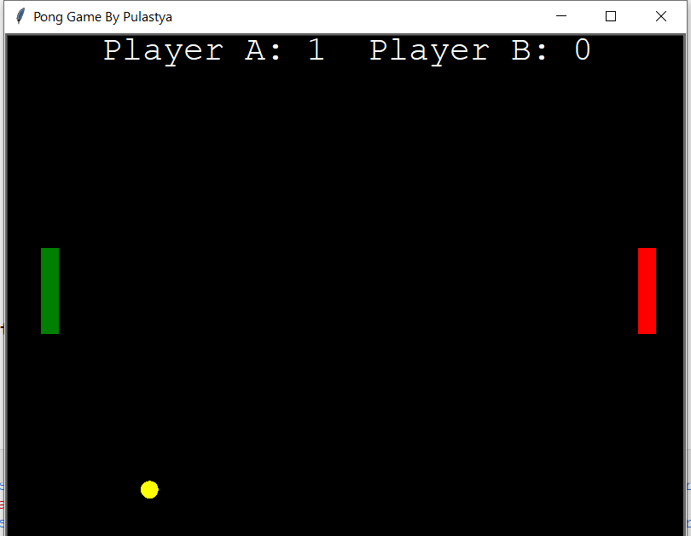
Ping-Pong Game
Using Python
Pawan. S. Varma – 19UET052
Ayush. C. Patil – 19UME072
Sanket. P. Pore – 19UME080

Slide 2
Index
What is Ping-Pong Game ?
Rules of the Game
Steps to Implement the Program
Data flow Diagram
Modules/Library Used
Advantages
Disadvantages
Conclusion

Slide 3
What it Ping-Pong Game ?
Ping-Pong is one of the most famous arcade games, simulating like table tennis.
Each player controls a paddle in the game by dragging it vertically across the screen’s left or right side.
Players use their paddles to strike back and forth on the ball.
Turtle is an inbuilt graphic module in Python. It uses a panel and pen to depict illustrations.

Slide 4
Rules of the Game
Ping-Pong is a two player game, player A on left and player B on right.
Both player only moves up and down by pressing key ‘w’ and ’s’ for player A, key ‘Up’ and ‘Down’ for player B.
Player who touches the ball scores one point which is recorded at the top of the game screen.
When the ball cross the board, game starts again.

Slide 5
Steps to Implement the Program
The following are the steps used for illustrating Ping-Pong game:
Step 1: The user has to create two Paddles for the "Left Side" and "Right Side" of the screen
Step 2: The user then has to create the ball.
Step 3: Then, create an event for moving the paddles vertically by pressing the particular keys, that is, for "Left Paddle": "R" for "Up" and "C" for "Down", for "Right Paddle": "Up key ()" for "Up" and "Down key ()" for "Down".
Step 4: At last, create the function for updating the score after each player misses the strike on the ball.

Slide 6
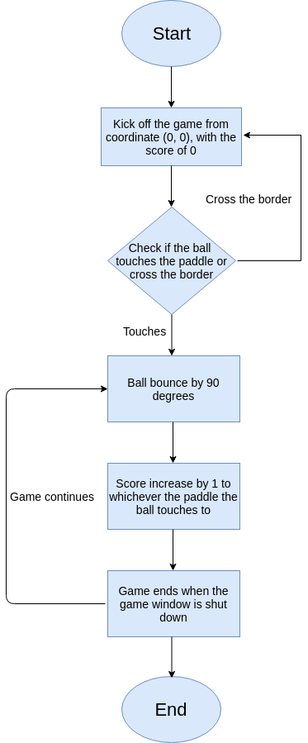
Data-flow diagram

Slide 7
Modules/Library Used
Turtle:
The turtle is the only module used in Ping-Pong Game. The turtle is a built-in module in Python which is used for graphical illustrations. The users can use it as a pen and panel to illustrate the graphics.
In Short, Turtle is a Python module that provides a drawing board like feature, which enables users to create pictures and shapes. Turtle is one of the most popular ways of introducing programming to kids. The turtle module provides turtle graphics primitives, in both object-oriented and procedure-oriented ways.

Slide 8
Advantages
The game is easy to understand and thus a person with minimum IQ can be able to play this game.
Rules of this game are very easy and anyone can play this game without any objection.
No need of giving any input after running the Program.
Only one in-built module is required.
This game can be mainly used for Entertainment Purpose.

Slide 9
Disadvantages
As it is a game, it should be played in a limit.
If played for long time, it will affect your eyes as well as other body parts.
Only two players can play at a time.
It does not have any scope in education field.

Slide 10
Conclusion
In this, we have created a simple illustration of a ping-pong game on the screen by using the built-in library of Python, that is, Turtle.
In this project we also discuss about what is this software and how it performed .
The user can create different moving illustrations by using the turtle library and its different functions.

